Slide 1

Lebanese international university
CSCI 440 – Project
A comparison in the running time between top down and bottom up merge sort in java
Khaled Nimr Charkie
21430034
Fall 2016 - 2017

Slide 2
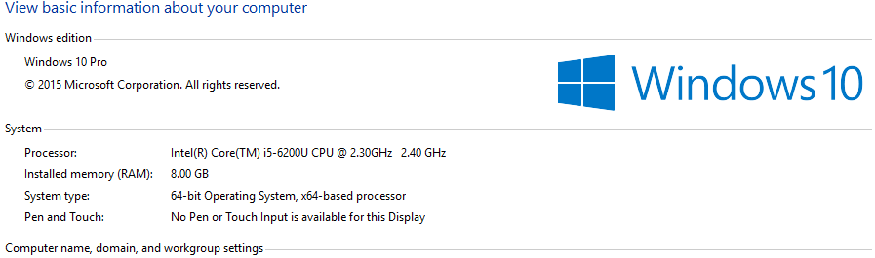
Specifications

Slide 3
What is merge sort?
Merge sort is a comparison based algorithm that uses divide and conquer approach to sort an array in O(n logn) time.
Merge sort is a stable sort i.e. it preserves the order of same array elements after sorting.
Algorithm for Merge sort is:
Step 1. Divide the array into 2 halves recursively.
Step 2. Merge the divided parts in sorted order.
Source:Quora.com

Slide 4
Top down Vs. bottom up
Any run of MergeSort can be visualized as a tree. The leaves of the tree are the individual elements of the array. Each inner node of the tree corresponds to merging two smaller arrays into one larger array.
The top-down implementation is the implementation that uses recursion. It starts at the top of the tree and proceeds downwards, each time asking the same question (what do I need to do to sort this array?) and answering it (split it into two, make recursive calls, merge results), until you get to the bottom of the tree.
The bottom-up implementation doesn't use recursion. It directly starts at the bottom of the tree and proceeds upwards by iterating over the pieces and merging them.
Source:Quora.com

Slide 5
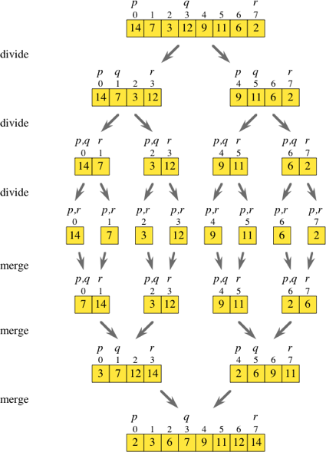
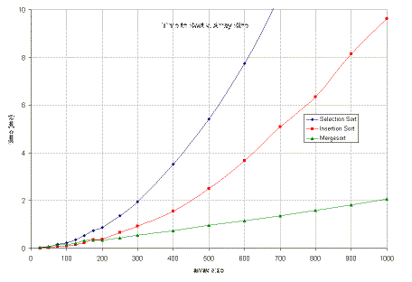
overview

Slide 6
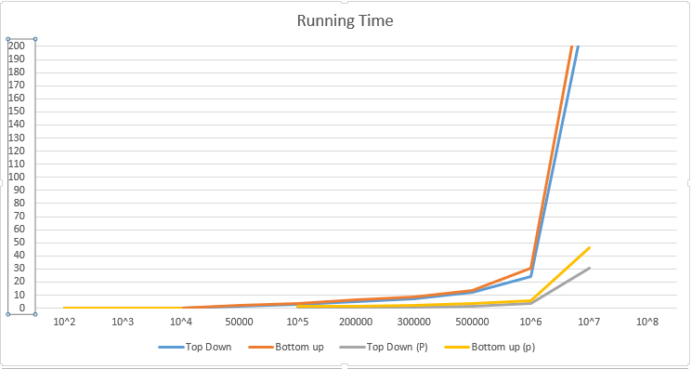
Running Time
Top down: printed line by line
Top down(p):printed on same line

Slide 7
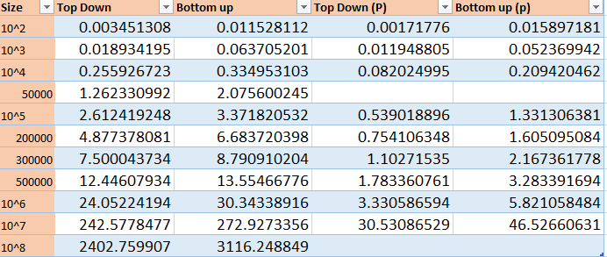

Slide 8

Conclusion
Conquer the small, blow up the big
One iteration may change it all

